Slide 1
Object Oriented Analysis and Design
-For BIT

Slide 2
Introduction
Procedure of identifying software engineering requirements and developing software specifications in terms of a software system’s object model, which comprises of interacting objects.
Requirements are organized around objects, which integrate both data and functions.
Modelled after real-world objects that the system interacts with
In traditional analysis methodologies, the two aspects - functions and data - are considered separately

Slide 3
Formal Defination
Grady Booch has defined OOA as,
“Object-oriented analysis is a method of analysis that examines requirements from the perspective of the classes and objects found in the vocabulary of the problem domain”.

Slide 4
OOA- History
The first object language was SIMULA in 1960
In 1970, Alan Kay and his research group at Xerox PARK created a personal computer named Dynabook and the first pure object-oriented programming language (OOPL) - Smalltalk, for programming the Dynabook.
In the 1980s, Grady Booch published a paper titled Object Oriented Design that mainly presented a design for the programming language, Ada. In the ensuing editions, he extended his ideas to a complete object–oriented design method.

Slide 5
Primary Tasks in OOA
Identifying objects
Organizing the objects by creating object model diagram
Defining the internals of the objects, or object attributes
Defining the behavior of the objects, i.e., object actions
Describing how the objects interact

Slide 6
Object Oriented Programming Features
Bottom–up approach in program design
Programs organized around objects, grouped in classes
Focus on data with methods to operate upon object’s data
Interaction between objects through functions
Reusability of design through creation of new classes by adding features to existing classes
Ex: C++, Java, Smalltalk, C#, Ruby, PHP etc

Slide 7
Feature of Object Oriented Language
Classes and object
Encapsulation and data hiding
Message Passing
Inheritance
Polymorphism

Slide 8
Benefits
It helps in faster development of software.
It is easy to maintain. Suppose a module develops an error, then a programmer can fix that particular module, while the other parts of the software are still up and running.
It supports relatively hassle-free upgrades.
It enables reuse of objects, designs, and functions.
It reduces development risks, particularly in integration of complex systems.

Slide 9
Phases in OOD
Object-oriented Analysis
Object-oriented Design
Object-oriented Implementation and Testing

Slide 10
UML Diagram
Unified Modeling Language
Modern Approach to modeling and documenting software
Created as result of the chaos revolving around software development as there were different ways to represent the system
A UML diagram is a diagram based on the UML (Unified Modeling Language) with the purpose of visually representing a system along with its main actors, roles, actions, artifacts or classes, in order to better understand, alter, maintain, or document information about the system.

Slide 11
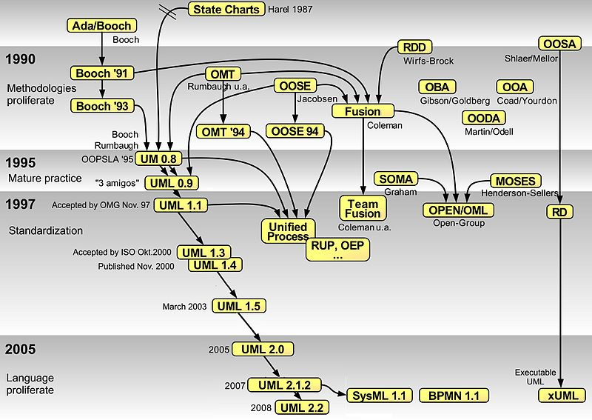

Slide 12
UML Design
Offers a ways to visualize a system’s architectural blueprint in a diagram, including elements as:
any activities (jobs);
individual components of the system;
and how they can interact with other software components;
how the system will run;
how entities interact with others (components and interfaces);
external user interface.

Slide 13
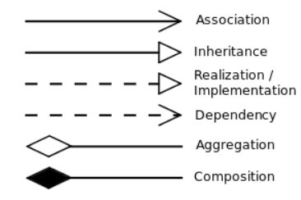
Some UML Notation
Aggregation: is part of Compostion: is entirely made of

Slide 14
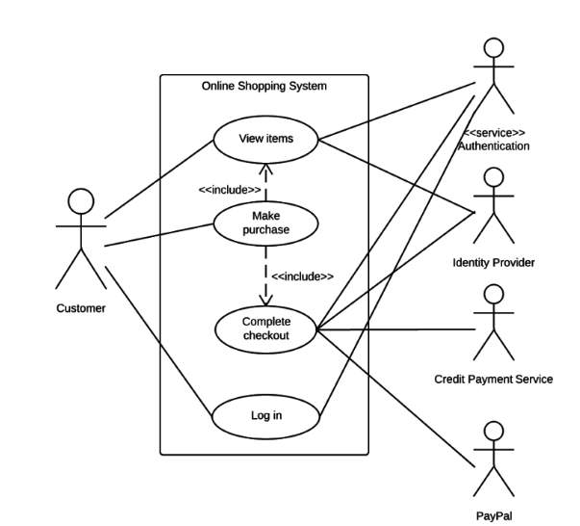
UML Example USE CASE

Slide 15
UML: Types
Behavioral UML
Activity Diagram
Use Case Diagram
Interaction Overview Diagram
Timing Diagram
State Machine Diagram
Communication Diagram
Sequence Diagram
Structural UML Diagram
Class Diagram
Object Diagram
Component Diagram
Composite Structure Diagram
Deployment Diagram
Package Diagram
Profile Diagram

Slide 16
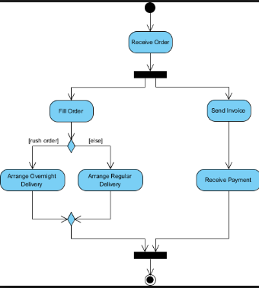
Activity Diagram

Slide 17
Use Case Diagram
Use Case diagrams are used to analyze the system’s high-level requirements.
These requirements are expressed through different use cases.
We notice three main components of this UML diagram:
Functional requirements – represented as use cases; a verb describing an action
Actors – they interact with the system; an actor can be a human being, an organization or an internal or external application
Relationships between actors and use cases – represented using straight arrows

Slide 18
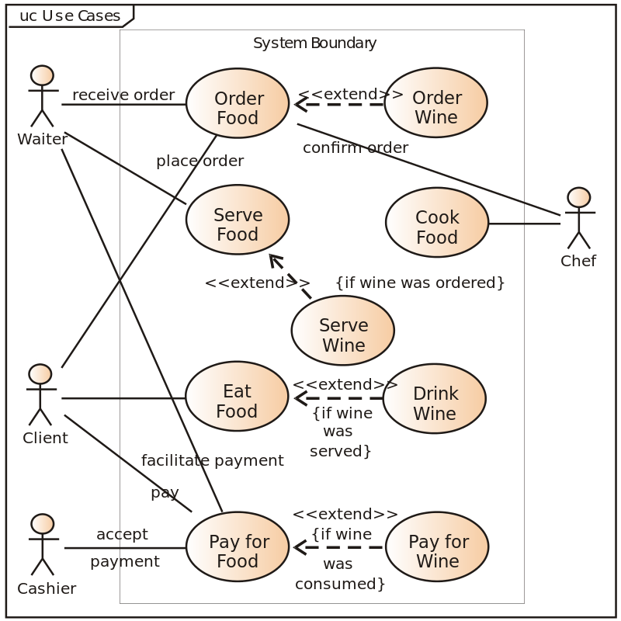
USE Case: Example

Slide 19
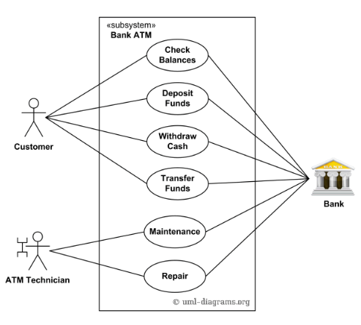
USE CASE: ATM System

Slide 20
Class Diagram
is a type of static structure diagram that describes the structure of a system by showing the system's classes, their attributes, operations (or methods), and the relationships among objects.
The class diagram is the main building block of object-oriented modeling.
It is used for general conceptual modeling of the structure of the application, and for detailed modeling translating the models into programming code.
Class diagrams can also be used for data modeling.

Slide 21
Structure
Classes are represented with boxes that contai
The top compartment contains the name of the class. It is printed in bold and centered, and the first letter is capitalized.
The middle compartment contains the attributes of the class. They are left-aligned and the first letter is lowercase.
The bottom compartment contains the operations the class can execute. They are also left-aligned and the first letter is lowercase

Slide 22
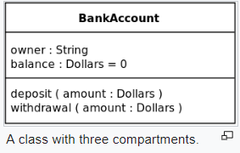
Example

Slide 23
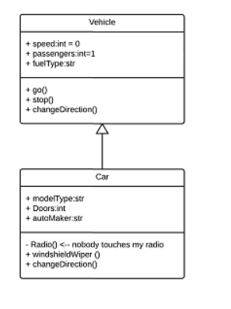
Interaction: Inheritance

Slide 24
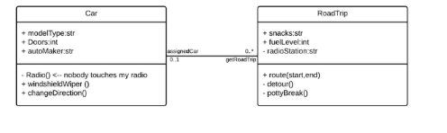
Interaction: Bidirectional association
The default relationship between two classes. Both classes are aware of each other and their relationship with the other. This association is represented by a straight line between two classes.

Slide 25
Member Access Modifier
Public (+)
Private (-)
Protected (#)
Package (~)
Derived (/)
Static (underlined)

Slide 26
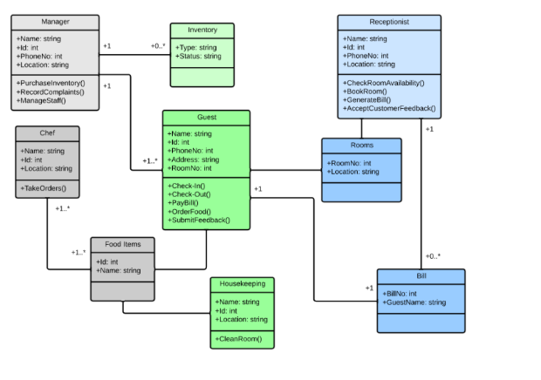
Example

Slide 27
Dynamic Modelling: State Diagram
Is a type of behavioral diagram in the Unified Modeling Language (UML) that shows transitions between various objects.
State diagrams mainly depict states and transitions.
States are represented with rectangles with rounded corners that are labeled with the name of the state.
Transitions are marked with arrows that flow from one state to another, showing how the states change.

Slide 28
Simple Example

Slide 29
State diagram applications
Depicting event-driven objects in a reactive system.
Illustrating use case scenarios in a business context.
Describing how an object moves through various states within its lifetime.
Showing the overall behavior of a state machine or the behavior of a related set of state machines.

Slide 30
State diagram symbols and components
Composite state
A state that has substates nested into it.

Slide 31
State diagram symbols and components
Choice pseudostate
A diamond symbol that indicates a dynamic condition with branched potential results
Event
An instance that triggers a transition, labeled above the applicable transition arrow. In this case, “classes end” is the event that triggers the end of the “Being taught” state and the beginning of the “Final exams” state.

Slide 32
Exit Point
The point at which an object escapes the composite state or state machine, denoted by a circle with an X through it. The exit point is typically used if the process is not completed but has to be escaped for some error or other issue.

Slide 33
First State
A marker for the first state in the process, shown by a dark circle with a transition arrow.

Slide 34
State
A rectangle with rounded corners that indicates the current nature of an object.
Guard
A Boolean condition that allows or stops a transition, written above the transition arrow.

Slide 35
Transition
An arrow running from one state to another that indicates a changing state.
Terminator
A circle with a dot in it that indicates that a process is terminated

Slide 36
Calendar availability state diagram example
This state machine diagram example shows the process by which a person sets an appointment on their calendar. In the “Check date” composite state, the system checks the calendar for availability in a few different substates. If the time is not available on the calendar, the process will be escaped. If the calendar shows availability, however, the appointment will be added to the calendar.

Slide 37
Calendar availability state diagram example

Slide 38
University state diagram
This state diagram shows the process of enrollment and classes at a university. The composite state “Enrollment” is made up of various substates that will lead students through the enrollment process. Once the student has enrolled, they will proceed to “Being taught” and finally to “Final exams.”

Slide 39
University State Diagram

Slide 40
Airport Check-in state diagram
The following example simplifies the steps required to check in at an airport. For airlines, a state diagram can help to streamline processes and eliminate unnecessary steps.

Slide 41
Airport Check-in state diagram

Slide 42
Sequence Diagram
A sequence diagram is a type of interaction diagram
It describes how—and in what order—a group of objects works together.
These diagrams are used by software developers and business professionals to understand requirements for a new system or to document an existing process.
Sequence diagrams are sometimes known as event diagrams or event scenarios.

Slide 43
Basic Symbol
Object symbol
Represents a class or object in UML. The object symbol demonstrates how an object will behave in the context of the system. Class attributes should not be listed in this shape.

Slide 44
Activation Box
Represents the time needed for an object to complete a task. The longer the task will take, the longer the activation box becomes.

Slide 45
Actor Symbol
Shows entities that interact with or are external to the system.

Slide 46
ATM Example
An ATM allows patrons to access their bank accounts through a completely automated process. You can examine the steps of this process in a manageable way by drawing or viewing a sequence diagram. The example below outlines the sequential order of the interactions in the ATM system. Just click to edit the template, and customize the sequence diagram so it suits your own needs.

